Slide 1
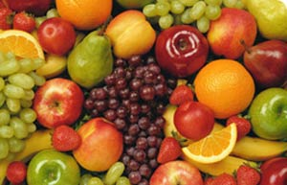
All about First Fruits

Slide 2

When we come to God through Christ - we are New Creations
2 Cor. 5:17 = All things New!
Everything changes!
  Eternal issues
  Temporal Issues
  God-accountability
  Our security
  Interests
  Values, ethics
  + Economics!

Slide 3

We enter the Upside-down Kingdom!
1st = Last
Greatest is least
Leaders = servants
Give and you'll receive
If someone strikes you on one cheek, turn to him the other also
Love your enemies; do good to those who hate you.
If someone takes your coat, do not stop him from taking your shirt.

Slide 4
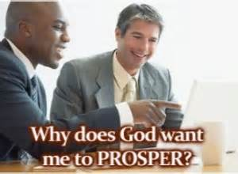
God wants you to have abundance/wealth!
Despite what you’ve heard before!

Slide 5
God’s Words for Your Prosperity
Psalm 68:19 – Blessed be the Lord who daily loads us with benefits
3 John 1:2 – I wish above all things you prosper and be in health as your souls prospers
Psalm 24:1 – The earth is the Lord’s and the fullness thereof
Psalm 115:15 – The Lord shall increase you more and more – you and your children
Psalm 145:16 – He opens His hand and satisfies every living thing

Slide 6
More of God’s Words for Your Prosperity
Deut 8:18 – Remember the Lord your God – he gives you power to get wealth – to establish His covenant...
Deut 28:6 – Blessed you shall you be when you come in – and when you go out......
Prov. 10:22 – The blessing of the Lord makes rich and adds no sorrow with it
Prov. 22 :4 – By humility and fear of Lord are riches and honour and life
Deut 29:29 – Keep the words of this covenant that you may prosper in all you do

Slide 7
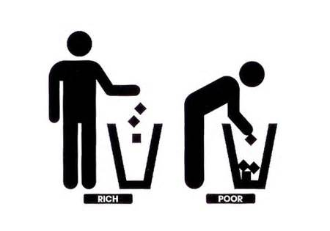

Two basic types attitude – toward money:
Budget mentality
Vision Mentality

Slide 8
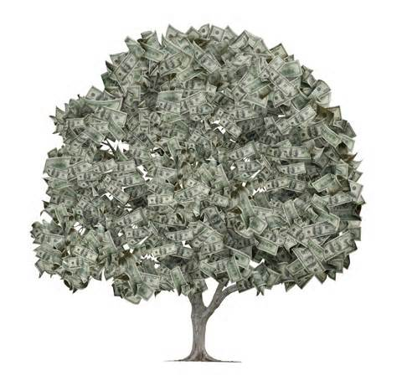
Jesus often taught on money -
Warned against mammon, love of money, priorities, covetousness,
Encouraged generosity, compassion, eternal values

Slide 9
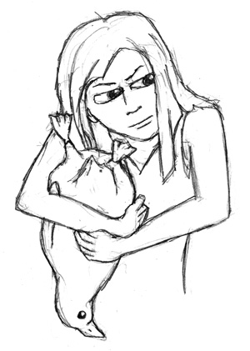
Jesus said " beware of covetousness" Luke 12:15-23
Covetousness is part of the old nature it creates 'economic hostages'
Covetousness makes you greedy, carnal, deaf to God, insensitive to His Spirit AND POOR!
Provide. 11:23 ..There is that scattereth, and yet increaseth; and there is that withholdeth more than is meet, but it tendeth to poverty.

Slide 10
4 Types of Giving in scripture
Tithes – 10th of all our income
  Promise is: Devourer rebuked,
  Heaven opened to over-flowing blessings upon the tither
Firstfruits – a natural gift of gratitude –
  Promise is full barns overflowing
  Includes every increase in wage or pay or government benefit
Alms – what we give to the needy – a gift of compassion.
Seed - your money being giving to God!

Slide 11
All about firstfruits
Firstfruits was a Jewish feast instituted by God held in the early spring at the beginning of the grain harvest. It was observed on Nissan 16, which was the third day after Passover and the second day of the Feast of Unleavened Bread. Firstfruits was a time of thanksgiving for God’s provision.
No grain was to be harvested at all until the firstfruits offering was brought to the Lord The offering was made in remembrance of Israel’s sojourn in Egypt, the Lord’s deliverance from slavery, and their possession of “a land that floweth with milk and honey.” The day of the firstfruits offering was also used to calculate the proper time of the Feast of Weeks.

Slide 12
SCRIPTURES ON FIRSTFRUITS
Old Testament –
God’s General Commands to Israel
“You shall not delay to offer from the fullness of your harvest and from the outflow of your presses. The firstborn of your sons you shall give to me. Exodus 22:29
“Speak to the people of Israel and say to them, When you come into the land that I give you and reap its harvest, you shall bring the sheaf of the firstfruits of your harvest to the priest, and he shall wave the sheaf before the Lord, so that you may be accepted. Leviticus 23:10-14,

Slide 13
SCRIPTURES ON FIRSTFRUITS
Old Testament –
All the best of the oil and all the best of the wine and of the grain, the firstfruits of what they give to the Lord, I give to you. Numbers 18:12
You shall take some of the first of all the fruit of the ground, which you harvest from your land that the Lord your God is giving you, and you shall put it in a basket, and you shall go to the place that the Lord your God will choose, to make his name to dwell there. And you shall go to the priest who is in office at that time and say to him, ‘I declare today to the Lord your God that I have come into the land that the Lord swore to our fathers to give us.’ Deuteronomy 26:2-4

Slide 14
At Times of Re-dedication
In Solomon’s Day - 2 Chronicles 31:5
As soon as the command was spread abroad, the people of Israel gave in abundance the firstfruits of grain, wine, oil, honey, and of all the produce of the field. And they brought in abundantly the tithe of everything.
In Nehemiah’s Day Nehemiah 10:35
We obligate ourselves to bring the firstfruits of our ground and the firstfruits of all fruit of every tree, year by year, to the house of the Lord; We will provide for the temple worship the following: the sacred bread, the daily grain offering, the animals to be burnt each day as sacrifices, the sacred offerings for Sabbaths, New Moon Festivalsr and our other offerings of wine, olive oil, and all kinds of fruit..We will not neglect the house of our God.
In the Restored/New Jerusalem
Ezekiel 44:30
And the first of all the firstfruits of all kinds, and every offering of all kinds from all your offerings, shall belong to the priests. You shall also give to the priests the first of your dough, that a blessing may rest on your house.

Slide 15
In the Restored/New Jerusalem
Ezekiel 44:30
And the first of all the firstfruits of all kinds, and every offering of all kinds from all your offerings, shall belong to the priests. You shall also give to the priests the first of your dough, that a blessing may rest on your house.

Slide 16
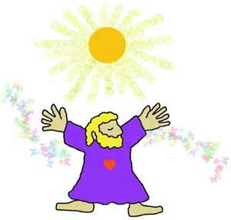
A General ‘Summary Command’
Honor the Lord with your wealth and with the firstfruits of all your produce;
then your barns will be filled with plenty, and your vats will be bursting with wine.

Slide 17
New Testament Scriptures on Firstfruits
But in fact Christ has been raised from the dead, the firstfruits of those who have fallen asleep. 1 Corinthians 15:20
Of his own will he brought us forth by the word of truth, that we should be a kind of firstfruits of his creatures. James 1:18
And not only the creation, but we ourselves, who have the firstfruits of the Spirit, groan inwardly as we wait eagerly for adoption as sons, the redemption of our bodies. Romans 8:23
If the dough offered as firstfruits is holy, so is the whole lump, and if the root is holy, so are the branches. Romans 11:16

Slide 18
God’s Protection is Upon His Harvest Preceded by Firstfruits Offering
Jeremiah 2:3
Israel was holy to the Lord, the firstfruits of his harvest. “All who ate of it incurred guilt; disaster came upon them, declares the Lord.”

Slide 19
SUMMARY OVERALL –
Old Testament
GOD INSTITUTED THE PRINCIPLE (COMMAND) OF FIRSTFRUITS TO HIS PEOPLE ISRAEL
AS ISRAEL BACKSLID, THEY SEEMINGLY FIRST FORGOT TITHES AND FIRSTFRUITS!
WHEN THEY REDEDICATED THEMSELVES – IT SEEMED THEIR FIRST RESPONSE WAS TO RESTORE TITHES FIRSTFRUITS OFFERINGS
THE PURPOSE OF FIRSTFRUITS WAS TO SECURE HIS OWNERSHIP OF THEM AND SECURE HIS PROTECTION AND BLESSING OVER THEM
THERE IS A DIRECT CORRELATION OF GOD’S PEOPLE HONOURING HIM WITH FIRSTFRUITS OFFERINGS AND HIS DESIRED BLESSINGS OF PROSPERITY UPON THEM. THE PEOPLE’S FAITHFULNESS IN THIS REGARD GUARANTEED THEIR BEST WELFARE

Slide 20
Summary – New Testament
JESUS IS NOW GOD’S FIRSTFRUIT (1 Cor. 15:20)
THE EARLY CHURCH WAS A FIRSTFRUIT TO GOD (James 1:18)
THE HOLY SPIRIT IS GOD’S FIRSTFRUIT TO US WHO BELIEVE (Rom. 8:23)
THE FIRSTFRUIT MUST BE HOLY – TO ENSURE A HOLY HARVEST (Rom. 11:16)

Slide 21
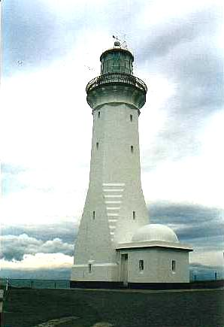
Honoring God means
Honouring His House
God’s House was languishing
  Note Hab. 1 “consider your ways”
God honors them who honor His house!
  Eli’s sons had backslidden –
  he lost God’s honour
  1 Sam. 2:30

