Slide 1
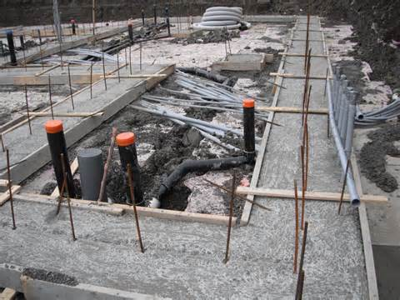
Foundations Foundations Foundations!
Foundations Foundations Foundations!

Slide 2
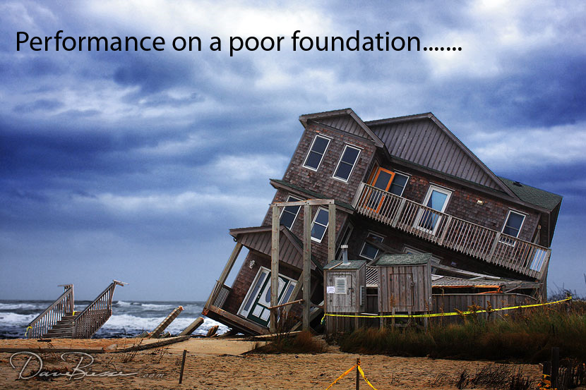
Everything Depends on Foundations
A Building
A Life for God
A mission/Project

Slide 3
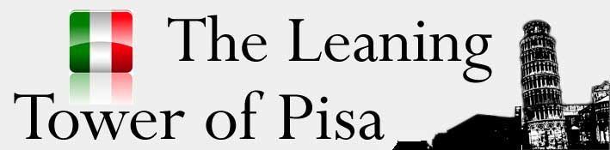
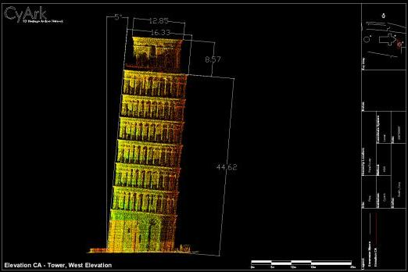

Slide 4
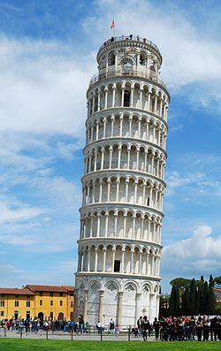
Interesting Facts About the
Leaning Tower of Pisa
The leaning tower of Pisa weighs 14,500 tonnes –
Europe 's most famous monument was the result of a slight miscalculation -.
The leaning tower of Pisa is only 55.86 meters tall -
It is a symbol of national pride -
It was upright for five years upon completion of its initial construction -
Construction was halted for 100 years -
A new architect resumed construction -.
A bad idea made the lean worse -
Mussolini tried to fix the tower -
The tower has 294 steps -
The tower was almost torn down

Slide 5

Some Sad Facts About us and buildings like the Leaning Tower of Pisa
We lean in the wrong direction
We do not fulfil the purpose we were designed for
We attract people for the wrong reason
We cannot carry the large bell that we were designed to!
Our 'lean' gets worse and worse through time
We exist precariously – on the brink of collapse and shame
The only answer is a radical re-visit to the foundations, excavate, re-fill and strengthen etc.

Slide 6
Foundations for Our Lives
E.g. Jesus
Vision for His life (given through prophecy to Mary and Joseph)
Good parenting (mentors) - examples
Discipline and training
Protection from foreign and dangerous contamination
Learnt the word of God (Torah)
Developed relationship with the Father
Life of prayer
Obedience to the Father and His word
The practice of Godly habits – honouring God’s house, respecting elders, etc

Slide 7
These are Foundations for your life – as a disciple of Jesus!
God’s Vision for your life
Good (spiritual) parenting/mentors) - examples
Discipline and training
Protection from foreign and dangerous contamination
Inculcation of the word of God
Develop relationship with the Father
Life of prayer
Obedience to the Father and His word
The practice of Godly habits – honouring God’s house, respecting elders, disciplines, etc.

Slide 8
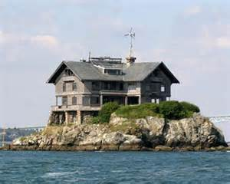
The House on the Rock
Therefore whoever hears these sayings of mine, and does them, I will liken him to a wise man, which built his house on a rock: And the rain descended, and the floods came, and the winds blew, and beat on that house; and it fell not: for it was founded on a rock. And every one that hears these sayings of mine, and does them not, shall be likened to a foolish man, which built his house on the sand: (Matt. 7:24-26)

Slide 9

The Church is Built on Good Foundations!
Eph 2:19-22 Now therefore ye are no more strangers and foreigners, but fellowcitizens with the saints, and of the household of God; And are built upon the foundation of the apostles and prophets, Jesus Christ himself being the chief corner stone; In whom all the building fitly framed together groweth unto an holy temple in the Lord In whom ye also are builded together for an habitation of God through the Spirit.

Slide 10


About the Mission/Project that God Has Given Us (at Lighthouse)

Slide 11
We are not just ‘holding the fort’, continuing a tradition, or just doing a good thing –
We are called to execute the vision and purposes of God in our generation!
  For David, after he had served his own generation by the will of God..... (Acts 13:36 )

Slide 12
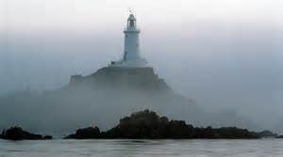
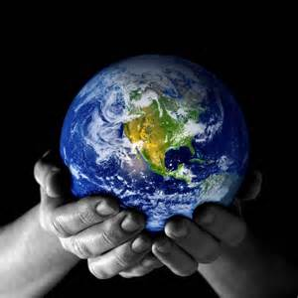
God’s Vision for Lighthouse
To be a Great Force for God in this Community
  Showing the way of salvation
  Making Disciples as Jesus Taught
  Displaying a people of God who are blessed
  Shining the Light of God through Good Works
  A Bride ready for Jesus’ Return
To be a Great Mission to Australia and the Ends of the Earth
  Reaching the poor and oppressed
  Establishing new churches and outreaches
  Breaking new ground - to those who’ve never heard

Slide 13
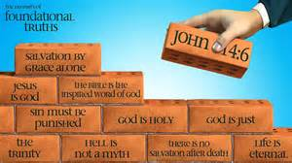
To Achieve this Vision – we need
Good Foundations!
Leadership with God’s Vision
Leadership with Godly Example
The Training of True Disciples of Jesus

