Slide 1


Slide 2

Immanuel - Recap
Immanuel - God with Us - makes the Gospel Good News, to us all. More than a Christmas cliché
Evidences of Immanuel = Life of Sonship; Life of Power; Life of God-likeness; and a life of Divine Favour
Who is this God with us? Almighty, creator of heaven and earth - macro and micro
He is also Father God who seeks a love relationship with us - full of grace and truth.

Slide 3
More Insights to our God
ELOHIM......Genesis 1:1, Psalm 19:1 "God" a compound noun - God's power and might.
ADONAI......Malachi 1:6 "Lord" a reference to the Lordship of God.
JEHOVAH--YAHWEH.....Genesis 2:4 a reference to God's divine salvation.

Slide 4
More Insights to our God
JEHOVAH-ROHI......Psalm 23:1 "The Lord my shepherd“
JEHOVAH-SHAMMAH.......Ezekiel 48:35 "The Lord who is present"
JEHOVAH-RAPHA.........Exodus 15:26 "The Lord our healer"
JEHOVAH-TSIDKENU......Jeremiah 23:6 "The Lord our righteousness"
JEHOVAH-JIREH.........Genesis 22:13-14 "The Lord will provide"
JEHOVAH-NISSI.........Exodus 17:15 "The Lord our banner"
JEHOVAH-SHALOM........Judges 6:24 "The Lord is peace"
JEHOVAH-SABBAOTH......Isaiah 6:1-3 "The Lord of Hosts"

Slide 5

God has a Wonderful Purpose for You!

Slide 6
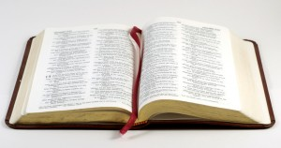
The Word of God (Bible):
The Itinerary for the Journey of Life!

Slide 7

God’s Plan involves:
Jesus’ death on The cross to redeem you - from sin to sonship
The sending of the Spirit to confirm your sonship
His Word – His guide and instructions for earthly living!
Giving you Talents!
Giving you an earthly assignment

Slide 8

Question for the Theologically Minded:
Did God send Jesus just to Rescue humankind from hell..... OR
Did God send Jesus to Restore us to his original intentions and purposes?

Slide 9
God’s Purpose for Us =
Sharing His Rule over the Universe!
^{Psalm 8}
⁴ When I see your heavens, the work of your fingers, the moon and stars that you set in place—
⁵ What are humans that you are mindful of them, mere mortals that you care for them?
⁶ Yet you have made them little less than ELOHIM, crowned them with glory and honour.
⁷ You have given them rule over the works of your hands, put all things at their feet...

Slide 10
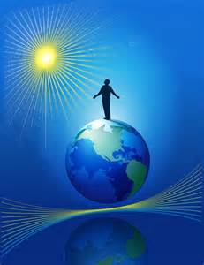
The Great Purpose of Life:
Ps 8:5-8 You made him to have dominion over the works of thy hands;
Hebrews 2:5, 7-10 For it was not to angels that he subjected the world to come, of which we are speaking...Yet at present we do not see “all things subject to him, but we do see Jesus “crowned with glory and honour”

Slide 11
Review:
God originally Created us to be WITH US – EXTENDING HIS ETERNAL PURPOSES
God is POWERFUL, ETERNAL, PERFECT, LOVING FATHER
Adam sold our his ‘birthright’ to Satan – we have suffered ever since!
God sent Jesus to deal with our problem and redeem us back to God AND His purposes (Rom.8:3-5)

Slide 12

You Were NOT an ‘Afterthought’!
Ephesians 1:4
He chose us in him, before the foundation of the world, to be holy and without blemish before him

Slide 13
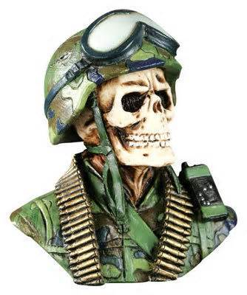
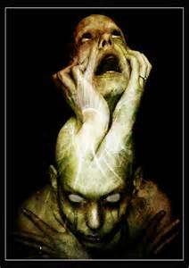
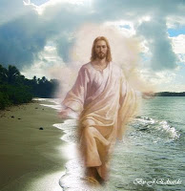
3 Types of People:
Carnal Jo
  Self-centred
Schizo Jo
  Mixed-up
Jesus Jo
  God’s man!

Slide 14
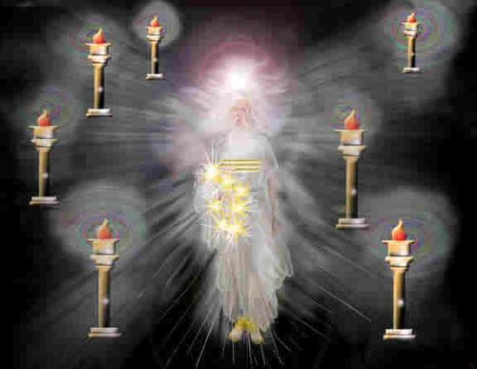
Some Eternal Purposes for Us:
Become LIKE Jesus (Rom. 8:28;1 John 3:2a)
See Jesus as He IS (1 John 3:2b)

Slide 15
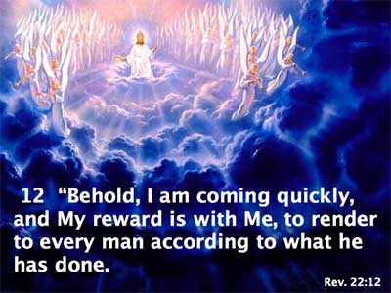
More Eternal Purposes for Us:
Receiving your rewards from Jesus (Rev. 22: 12)
Worship God – in Spirit and truth (John 4:23)

Slide 16
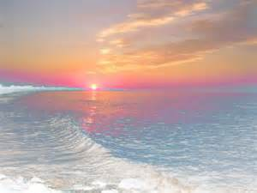
More Eternal Purposes for Us:
Allocation of a ‘Heavenly Home’ (John 14:2-3)
Judging the Angels (1 Cor. 6:3)
Priestly Ministry (1 Peter 2:9)
Ruling the domains of God as allocated by Him according to our faithfulness on earth (Matt. 25:21)

Slide 17
God’s Challenge – 2 Peter 3:10-13
But the day of the Lord will come like a thief, and then the heavens will pass away with a mighty roar and the elements will be dissolved by fire, and the earth and everything done on it will be found out. Since everything is to be dissolved in this way, what sort of persons ought (you) to be, conducting yourselves in holiness and devotion, waiting for and hastening the coming of the day of God, because of which the heavens will be dissolved in flames and the elements melted by fire. But according to his promise we await new heavens and a new earth in which righteousness dwells.

Slide 18
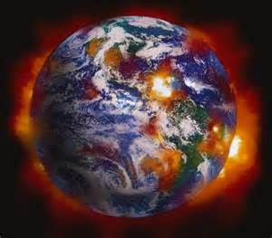
God’s Challenge -
Seeing then that all these things shall be dissolved, what manner of persons ought ye to be in all holy conversation and godliness...?

Slide 19

IMMANUEL – Because of Jesus!
To ensure all this can take place!

Slide 20

Yet..............
“Immanuel” Increases in an Obedient Life!

Slide 21
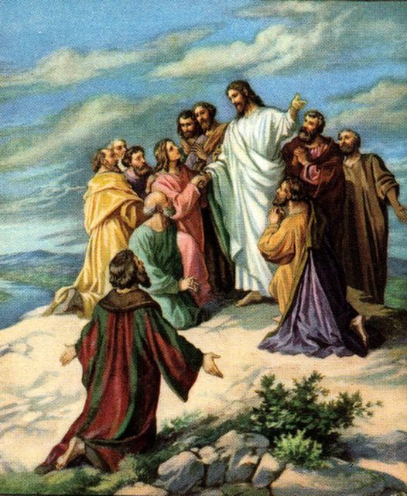
Jesus said: (His Great Commission)
¹⁸ “I have been given complete authority in heaven and on earth. ¹⁹ Therefore, go and make disciples of all the nations, baptizing them in the name of the Father and the Son and the Holy Spirit. ²⁰ Teach these new disciples to obey all the commands I have given you. And be sure of this: I am with you always, even to the end of the age.” (Matt:28:19-20)

