Slide 1


Slide 2
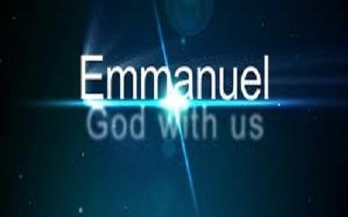
How to Guarantee it!

Slide 3
What is a “Christian”?
The word “Christian” is the ‘earthly religious name’ for those who followed Jesus
Act 11:26 And when he had found him, he brought him unto Antioch. And it came to pass, that a whole year they assembled themselves with the church, and taught much people. And the disciples were called Christians first in Antioch.
In Pliny’s Annals he relates that "by vulgar appellation [they were] commonly called Christians“ and identifies Christians as Nero's scapegoats for the Great Fire of Rome

Slide 4
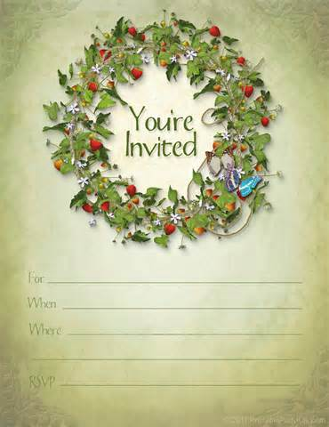
The Good News of Jesus (The gospel) is:
God, the creator of all things, is looking for those who will accept his invitation to be redeemed and born into His family to achieve His eternal purposes.
He has made this provision through His son (who’s earthly name was ‘Jesus of Nazareth’).

Slide 5
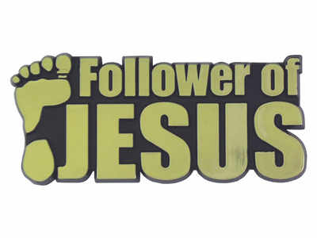
Therefore - what is a Christian?
One who follows Jesus.
One who believes in Jesus and obeys him –
A DISCIPLE of Christ

Slide 6

Another Way of Describing the Gospel
The Maker of all human beings (GOD) is recalling all units manufactured, regardless of make or year, due to a serious defect in the primary and central component of the heart.

Slide 7

Recall Notice
This is due to a malfunction in the original prototype units code named Adam and Eve, resulting in the reproduction of the same defect in all subsequent units.
This defect has been identified as "Subsequential Internal Non-morality," more commonly known as S.I.N., as it is primarily expressed.

Slide 8
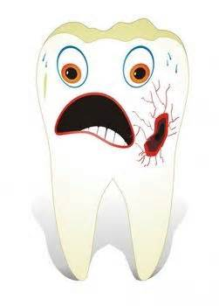
Some of the symptoms include:
1. Loss of direction 2. Foul vocal emissions 3. Amnesia of origin 4. Lack of peace and joy 5. Selfish or violent behavior 6. Depression or confusion 7. Fearfulness 8. Idolatry 9. Rebellion

Slide 9
Recall Instructions
The Manufacturer, who is neither liable nor at fault for this defect, is providing factory-authorized repair and service free of charge to correct this defect.
The Repair Technician, JESUS, has most generously offered to bear the entire burden of the staggering cost of these repairs. There is no additional fee required.
The number to call for repair in all areas is: P-R-A-Y-E-R. Once connected, please upload your burden of SIN through the REPENTANCE procedure.
Next, download ATONEMENT from the Repair Technician, Jesus, into the heart component.

Slide 10
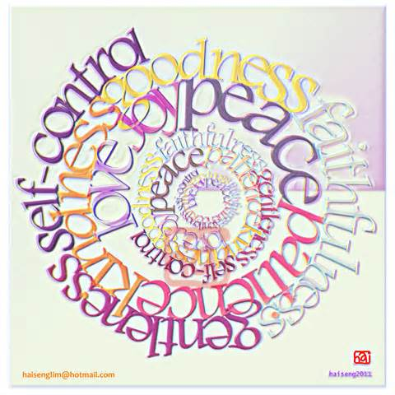
Guarantee
No matter how big or small the SIN defect is, Jesus will replace it with:
Love
Joy
Peace
Patience
Kindness
Goodness
Faithfulness
Gentleness
Self-control
Please see the operating manual, the B.I.B.L.E. (BEST Instructions Before Leaving Earth) for further details on the use of these fixes

Slide 11

Caution
WARNING: Continuing to operate the human being unit without correction voids any manufacturer warranties, exposing the unit to dangers and problems too numerous to list, and will result in the human unit being permanently impounded. For free emergency service, call on Jesus.
DANGER: The human being units not responding to this recall action will have to be scrapped in the furnace. The SIN defect will not be permitted to enter Heaven so as to prevent contamination of that facility.
Thank you for your attention!

Slide 12
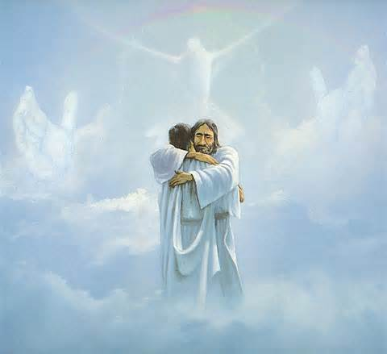
Jesus is not only
The most worth hero
The most worthy example for us to follow BUT
He is the ONLY option that God has provided
To REPAIR us – remedy our faults
To RESTORE us – to Divine Sonship
To REDEFINE our eternal purpose

Slide 13
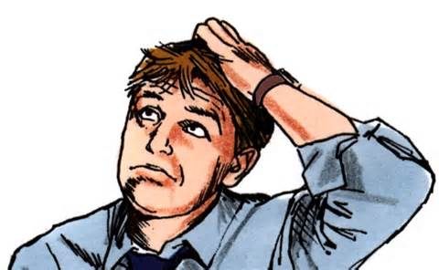
There are five kinds of Christians:
Active,
Professing,
Liturgical,
Private and
Cultural Christians.

Slide 14
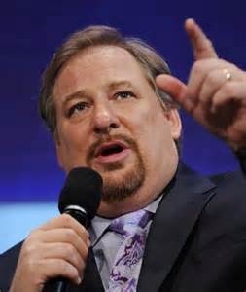
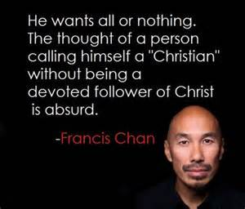
Passive Christian?
If you want to remain a passive Christian, find another church.

Slide 15

Good News
But when we realise God’s incredible plan and purposes for us, His instructions, exhortations, advice, commands etc are no longer grievous to us but EAGERLY WELCOME!
God’s Words

Slide 16
Psalm 19 - David welcomes God’s word
⁸ The law of the LORD is perfect, refreshing the soul.
The decree of the LORD is trustworthy, giving wisdom to the simple.
⁹ The precepts of the LORD are right, rejoicing the heart.
The command of the LORD is clear, enlightening the eye.
¹⁰ The fear of the LORD is pure, enduring forever.
The statutes of the LORD are true, all of them just;
¹¹ More desirable than gold, than a hoard of purest gold, Sweeter also than honey or drippings from the comb.
¹² By them your servant is instructed; obeying them brings much reward

Slide 17

Examples of God’s Welcoming Words
Be Fully Surrendered
Be Holy
Be Worshipful
Be Obedient
Be Generous
Be Loving (to neighbour)
Be Filled with His Spirit
Be Transformed
Support God’s House

Slide 18
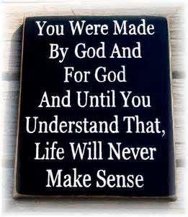
The Purpose of God for you
You were NOT made to be alone and without God
But made and called to be WITH God,
in harmony with God,
and flowing with God

