Slide 1


a Wonderful Gospel!
God With Us

Slide 2
The Writer to Hebrews Emphasises How Privileged we are:
Heb. 2:1-4 how shall we escape if we ignore so great a salvation?
Heb. 6:1-6 let us leave behind the basic teaching about Christ and advance to maturity
Heb. 12:1-7 let us rid ourselves of every burden and sin that clings to us and persevere in running the race that lies before us while keeping our eyes fixed on Jesus, the leader and perfecter of faith.

Slide 3
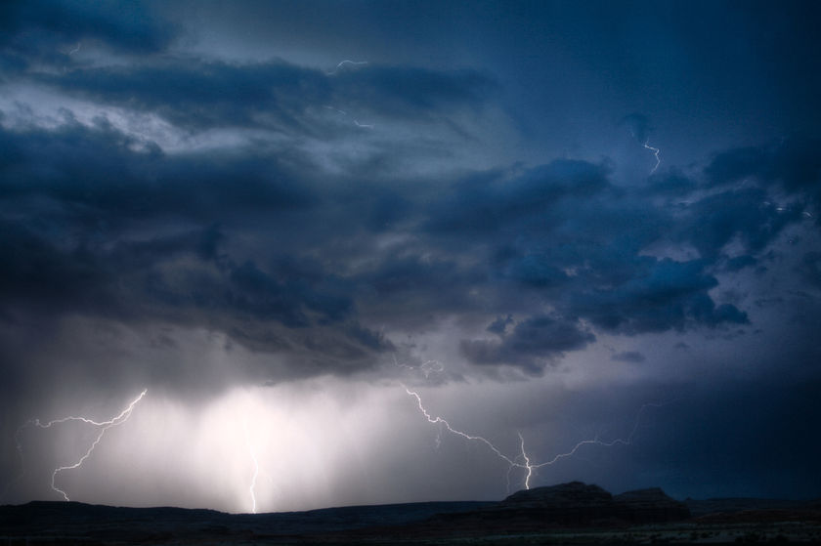
Storms/Winds of Adversity Coming:
Personal Benefits Gospel (centred around ME. Get Rich Quick, “How to....” etc.)
Greasy Grace Gospel (‘evil grace’ – you can keep sinning and keep getting forgiven!)
Sizzling Sensational Gospel (everything is a miracle, God does everything – mighty things – you don’t have suffer/pay the price or to do anything!)

Slide 4

This is the (TRUE) Gospel:
God Who loves us, has sent His son to the world,
to save us from sin,
restore us as sons of God,
to live fruitful lives on this earth, and
to live eternally with Him in His Kingdom

Slide 5

The 3 R’s of the Gospel:
Removal of sin
Reception of the Spirit
Restoration of Purpose

Slide 6

1 Removal of Sin –
What is SIN?
The Terminal Disease of the Soul
That which causes us to do Evil
Our Offences before God
Anything that violates our relationship with God

Slide 7
SIN is DEADLY
James 1:15 Then when lust hath conceived, it bringeth forth sin: and sin, when it is finished, bringeth forth death.
Rom 5:12 Wherefore, as by one man sin entered into the world, and death by sin; and so death passed upon all men, for that all have sinned:

Slide 8
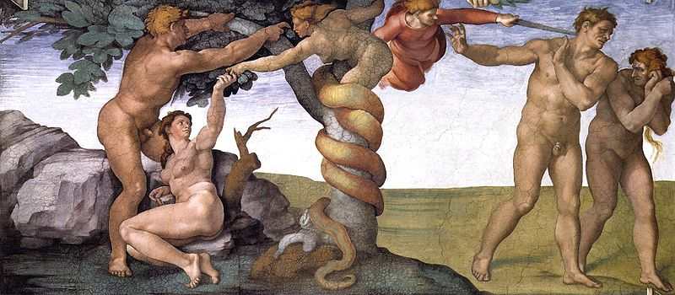
The Expulsion of Adam and Eve from the Garden of Eden

Slide 9
Jesus Came to Remove SIN!
John 1:29 John sees Jesus coming to him, and said, Behold the Lamb of God, which takes away the sin of the world.
John 8:34 Jesus answered them, Truly, truly I say to you, Whoever commits sin is the servant of sin.
Luke 5:32 I came not to call the righteous, but sinners to repentance.

Slide 10
Jesus Came to Remove SIN!
1 Peter 2:22 Who did no sin, neither was guile found in his mouth:
Rom 5:8 But God commendeth his love toward us, in that, while we were yet sinners, Christ died for us.
1Ti 1:15 This is a faithful saying, and worthy of all acceptation, that Christ Jesus came into the world to save sinners; of whom I am chief.

Slide 11
JESUS - The Solution to SIN
Rom 6:11 Likewise reckon ye also yourselves to be dead indeed unto sin, but alive unto God through Jesus Christ our Lord.
Rom 6:23 For the wages of sin is death; but the gift of God is eternal life through Jesus Christ our Lord
Col 1:14 In whom we have redemption through his blood, even the forgiveness of sins:
1 John 1:7 But if we walk in the light, as he is in the light, we have fellowship one with another, and the blood of Jesus Christ his Son cleanseth us from all sin.

Slide 12
JESUS - The Solution to SIN
Rom 8:2 For the law of the Spirit of life in Christ Jesus hath made me free from the law of sin and death.
1John 3:9 Whosoever is born of God doth not commit sin; for his seed remaineth in him: and he cannot sin, because he is born of God.
Rev 1:5 And from Jesus Christ, .....Unto him that loved us, and washed us from our sins in his own blood...

Slide 13
3 – Restoration of Purpose

