Slide 1

Vision/Theme for 2013
Immanuel
GOD WITH US!

Slide 2


A Wonderful Gospel!
God With Us

Slide 3

JESUS IS GOD’S ‘IMMANUEL’
Therefore the Lord himself will give you a sign: behold, a virgin shall conceive, and bear a son, and shall call his name Immanuel. (Isaiah 7:14 ASV)
Now all this is come to pass, that it might be fulfilled which was spoken by the Lord through the prophet, saying, Behold, the virgin shall be with child, and shall bring forth a son, And they shall call his name Immanuel; (Matthew 1:22, 23 ASV)

Slide 4
What are the Evidences of
GOD WITH US?
1 A life of Sonship
  Jesus Introduced God as Father!
  We are no longer orphans!
  Mat 5:16 Let your light so shine before men, that they may see your good works, and glorify your Father which is in heaven.
  ⁴⁴But I say: Love your enemies! Pray for those who persecute you! ⁴⁵In that way you will be acting as true sons of your Father in heaven.

Slide 5
What are the Evidences of
GOD WITH US?
2 A Life of Power
  for no one can do these signs that thou doest, except God be with him. (John 3:1, 2 ASV)
  How God anointed Jesus of Nazareth with the Holy Ghost and with power (Acts 10:38 )
  He that believeth on me, the works that I do shall he do also; and greater works than these shall he do (John 14:12 )

Slide 6

A Life of Power
Irenaeus wrote in Against Heresies 5:6:1 (A.D. 185):
“In like manner we do also hear many brethren in the church, who possess prophetic gifts, and who through the Spirit speak all kinds of languages, and bring to light for the general benefit the hidden things of men, and declare the mysteries of God. “

Slide 7
What are the Evidences of
GOD WITH US?
3 A Life of God-Likeness
But the fruit of the Spirit is love, joy, peace, longsuffering, gentleness, goodness, faith, Meekness, temperance: against such there is no law. (Gal 5:22-23 )
Whereby are given unto us exceeding great and precious promises: that by these you might be partakers of the divine nature (2 Peter 1:4 )

Slide 8
What are the Evidences of
GOD WITH US?
4 A Life of God’s Favour
...to proclaim the year of the Lord’s favour. (Luke 4:19)
At an acceptable time I have listened to you, and on a day of salvation I have helped you.”See, now is the acceptable time; see, now is the day of salvation! (2 Cor. 6:2)
At just the right time, I heard you. On the day of salvation, I helped you.” Indeed, God is ready to help you right now. Today is the day of salvation. (NLB)
When the time came for me to show you favourI heard you; when the day arrived for me to save you,I helped you.” Listen! This is the hour to receive God’s favour; today is the day to be saved! (GNB)

Slide 9
Jesus – Immanuel
God With Us!
Jesus came to relate us back to the Father
Jesus came to give us a life of Power
Jesus came to restore to us God’s Likeness
Jesus came to Open Heaven up for us and give us a life of Divine Favour!

Slide 10
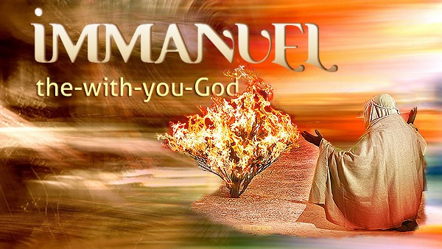

Slide 11
Vision/Theme for 2013
Immanuel
GOD WITH US!

Slide 12
A Wonderful Gospel!
God With Us

Slide 13
JESUS IS GOD’S ‘IMMANUEL’
Therefore the Lord himself will give you a sign: behold, a virgin shall conceive, and bear a son, and shall call his name Immanuel. (Isaiah 7:14 ASV)
Now all this is come to pass, that it might be fulfilled which was spoken by the Lord through the prophet, saying, Behold, the virgin shall be with child, and shall bring forth a son, And they shall call his name Immanuel; (Matthew 1:22, 23 ASV)

Slide 14
Jesus – Immanuel
God With Us!
Jesus came to relate us back to the Father
Jesus came to give us a life of Power
Jesus came to restore to us God’s Likeness
Jesus came to Open Heaven up for us and give us a life of Divine Favour!

Slide 15
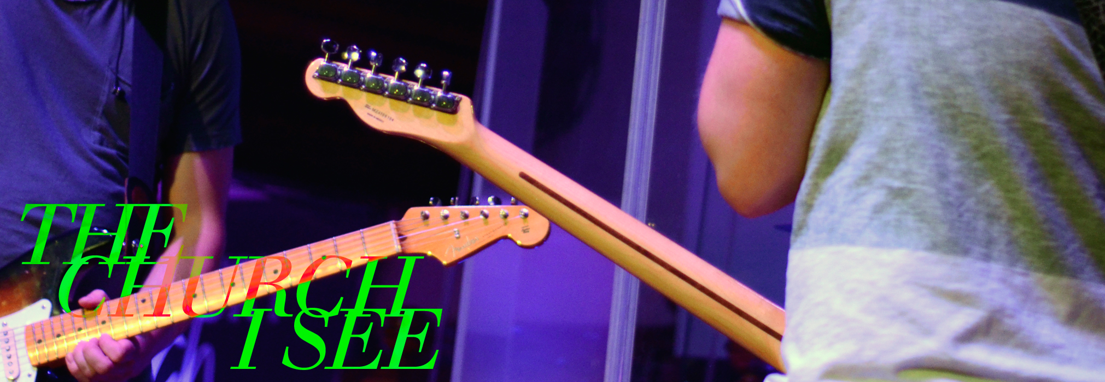

The Church I See in 2013
IN 2013

Slide 16
The Church I See in 2013
Note: The Church is the People - not the building, nor the congregation gathered, but
  Salt and light in the world
  The ‘Body of Christ’ in the earth
  The ‘Bride of Christ’
  The Kingdom of God in the earth
The Church is the corporate community of God’s people who have truly experienced salvation in Christ and continue to follow Him

Slide 17
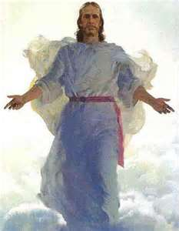
The Church I See in 2013
  People have encountered the living Christ
  They have an intimate relationship with God
  Are being transformed to become more like Jesus
  Are unashamedly separated from the world – it’s standards, culture, and gravity
  Are experiencing GOD WITH US and in ‘hot-pursuit’ of all that Jesus purchased on the cross from them

Slide 18

The Church I See in 2013
  Where people love God and one another in spite of their differences and dislikes
  Where they love ‘the house of God’ – to worship in spirit and in truth, to minister and to grow
  Where people love to pray, read their Bibles and fellowship

Slide 19


The Church I See in 2013
  Where people are incredibly generous, positive, confident and outgoing – influencing their friends and community
  Where people are hard-working, honest, and genuine human beings
  Where families are strong because of genuine obedience to God’s word – marriages/parents/children all complying!

Slide 20
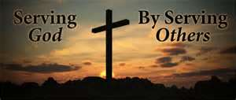
The Church I See in 2013
I see Lighthouse Church where:
  People are living Spirit-filled lives
  People are willing to minister and serve God in whatever capacity
  People have a heart for the lost – and will let their light shine wherever
  People are willing to ‘shepherd the sheep’, live sacrificially, an ‘do what it takes’ to grow the Kingdom

Slide 21

The Church I See in 2013
That is doing ‘good works’
  Feeding the hungry
  Ministering to orphans, widows, etc
  Interfacing with the community (Op Shop etc)
  Has a WORLD FOCUS (as well as local) - MISSIONS being part of its DNA
Amen!

Slide 22
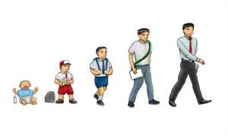

The Church I See in 2013
That is GROWING
  In physical numbers
  In spiritual strength
  In community impact
  In Apostolic Influence

Slide 23

The Church I See in 2013
  Young people are smart enough not to follow the crowd,
  Visionary enough to study and work hard toward their goals, and
  Gutsy enough to be different for the cause of Christ

Slide 24

The Church I See in 2013
  Where people are not afraid to live by Biblical standards, and though they maybe called ‘old-fashioned’ - they’d prefer to guarantee God’s kingdom inheritance rather than foolishly risking the loss of it for poultry temporal pleasures

Slide 25
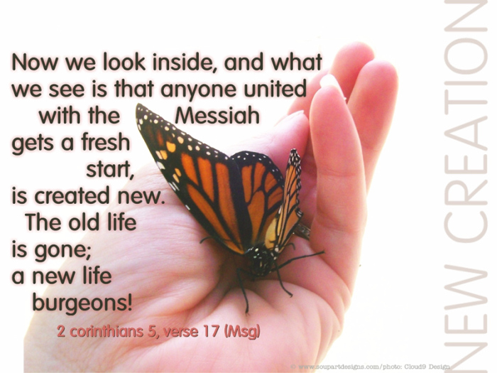
SUMMARY OF
‘THE CHURCH I SEE IN 2013’
A COMMUNITY OF PEOPLE THAT IS:
  Christ-like and becoming more what God wants them to be
  Different from the world and even different from most of their Christian counterparts

Slide 26
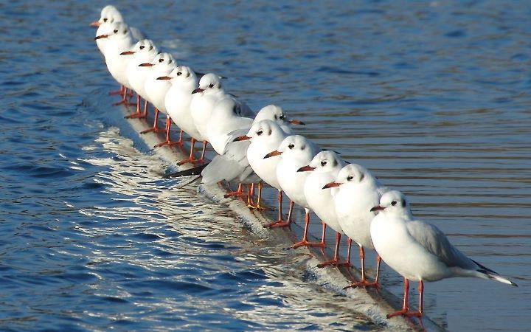
DIFFERENT IN THE
FOLLOWING WAYS:
IN EXPERIENCE
IN AFFECTIONS
IN LIFESTYLE
CHRISTIAN SERVICE
WORLD-VIEW
GROWTH/HEALTH
YOUTH CULTURE
COMMITMENT

Slide 27



Slide 28
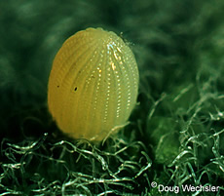
4 Stages of Metamorphosis
- The Egg (seed)
Do not conform to the pattern of this world, but be transformed by the renewing of your mind. Then you will be able to test and approve what God’s will is—his good, pleasing and perfect will.
Rom. 12:2

Slide 29
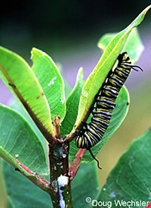
4 Stages of Metamorphosis
2 - The Caterpillar
The Feeding Stage

Slide 30
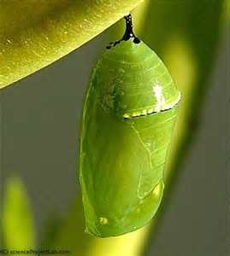
4 Stages of Metamorphosis
Pupa: The Transition Stage
(Chrysalis)

Slide 31
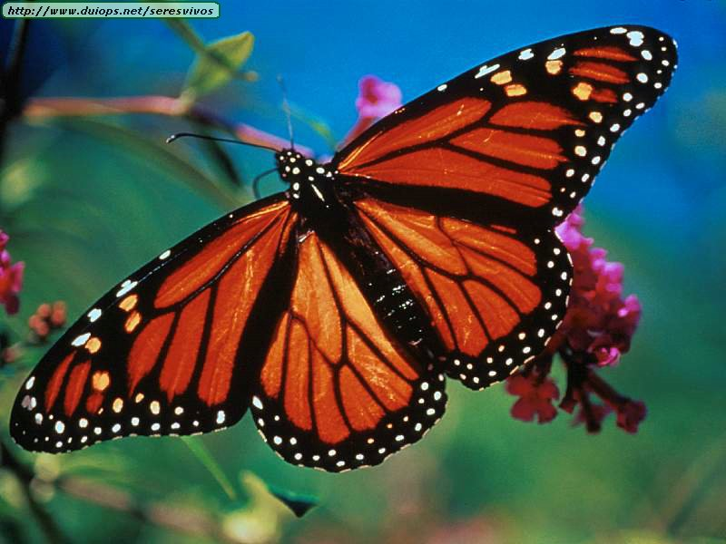
4 Stages of Metamorphosis
4 - Adult: The Reproductive Stage

