Slide 1
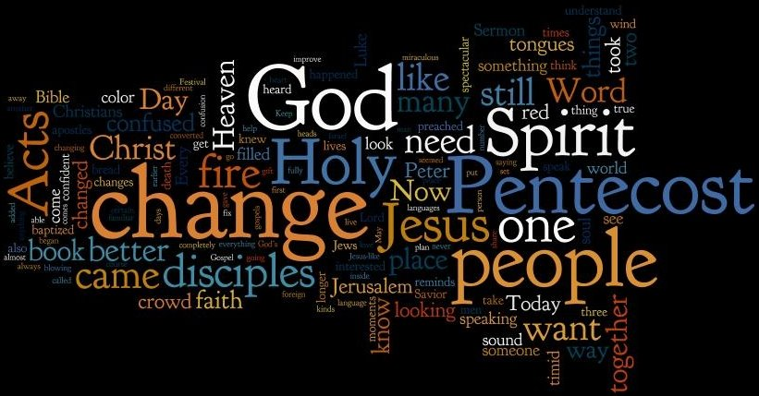
The House that Jack Built and the Church that Jesus Built

Slide 2
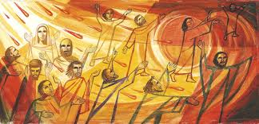
The Church that Jesus Built
This is the Church that
Jesus Built

Slide 3
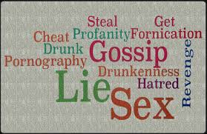
This is the Yeast that Lay in the Church that Jesus Built
This is the yeast that lay in the Church that Jesus built

Slide 4
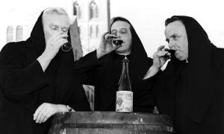
This is the result of the yeast that lay in the church that Jesus Built

Slide 5
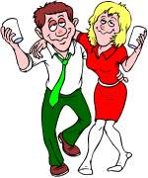
This is a disciple who ignored the yeast that lay in the church that Jesus built

Slide 6
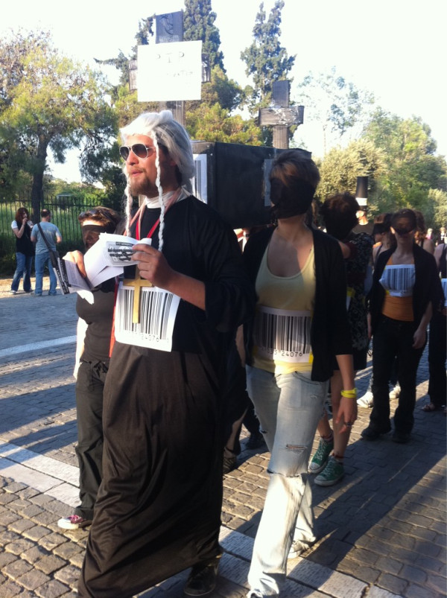
This is the priest that was a disciple that ate the yeast that lay in the church that Jesus Built

Slide 7

This is the mess made by the priest who was a disciple, who ate the yeast that lay in the church that Jesus built

Slide 8
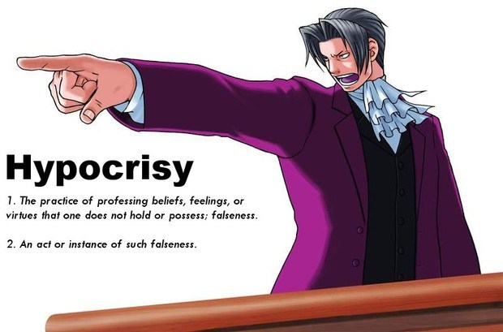
This is the hypocrisy caused by the mess made by the priest who was a disciple, who ate the yeast that lay in the church that Jesus Built

Slide 9
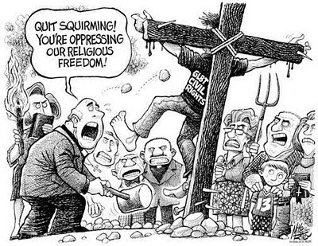
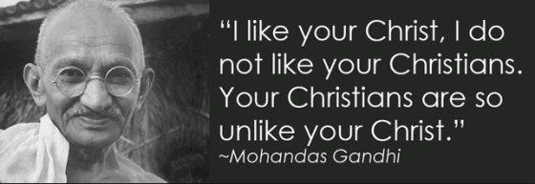
This is the mockery of the hypocrisy caused by the mess made by the priest who was a disciple, who ate the yeast that lay in the church that Jesus Built

Slide 10
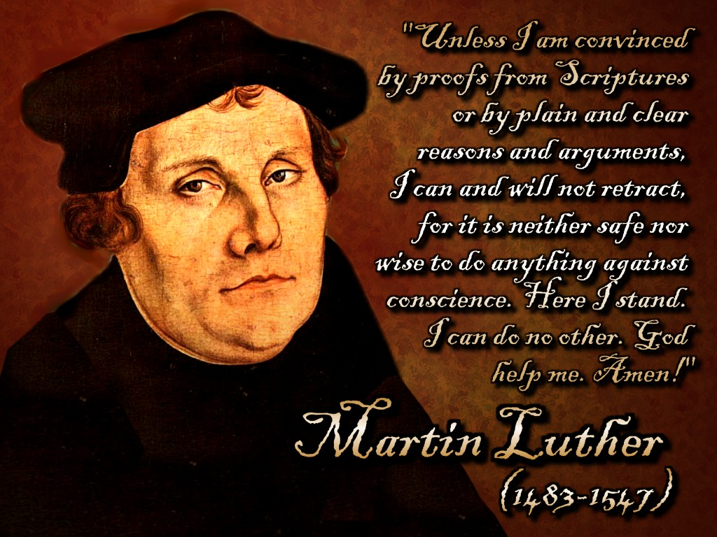
This is the man who stood against the mockery of hypocrisy caused by the mess made by the priest who was a disciple, who ate the yeast that lay in the church that Jesus Built

Slide 11
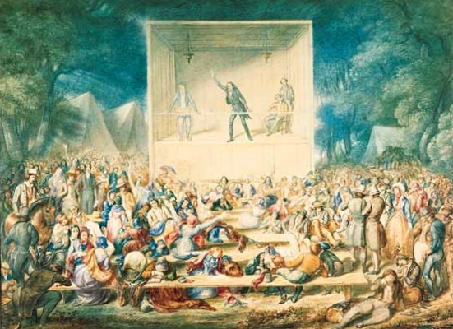
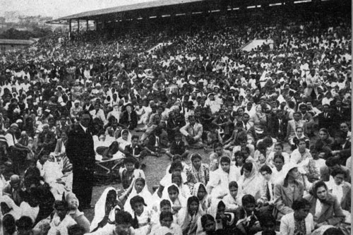
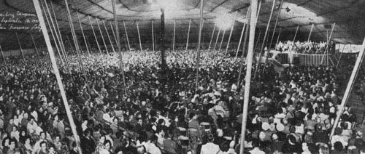
These are the revivals which followed the man who stood against the mockery of hypocrisy caused by the mess made by the priest who was a disciple, who ate the yeast that lay in the church that Jesus Built

Slide 12
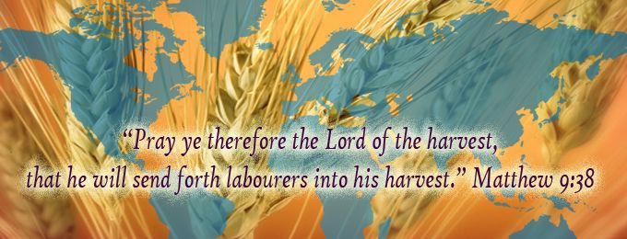
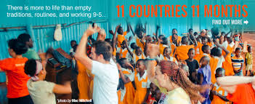
These are the Missions that came out of the revivals which followed the man who stood against the mockery of hypocrisy caused by the mess made by the priest who was a disciple, who ate the yeast that lay in the church that Jesus Built

Slide 13
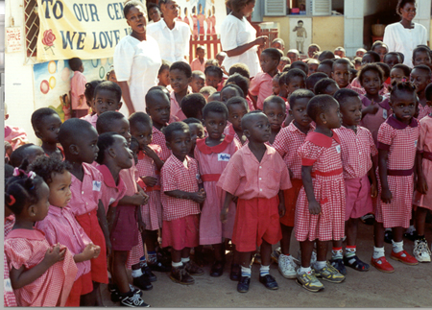
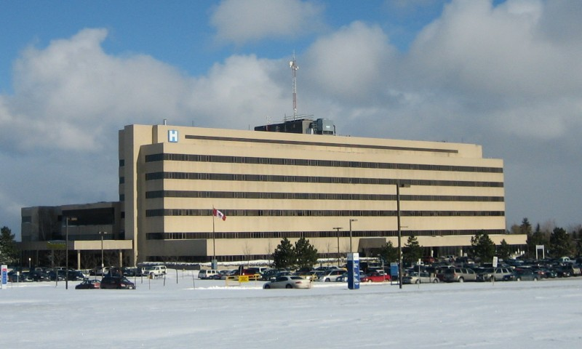
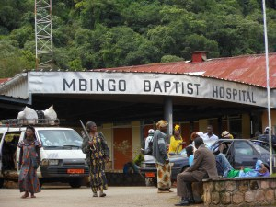
These are the schools hospitals and humanitarian institutions that were birthed out of the missions which came from revivals which followed the man who stood against the mockery of hypocrisy caused by the mess made by the priest who was a disciple who ate the yeast that lay in the church that Jesus Built

Slide 14
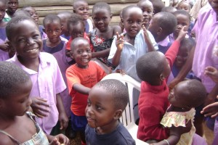
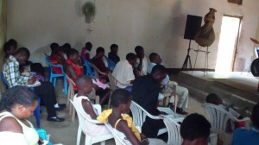
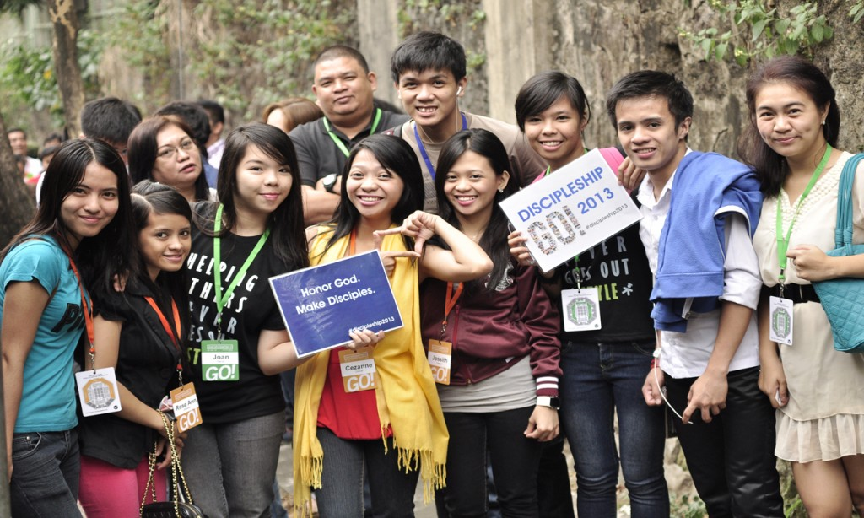
These are the true disciples of Jesus who make disciples, who maintain the schools hospitals and humanitarian institutions which came from missions. that were birthed out of the revivals which followed the man who stood against the mockery of hypocrisy caused by the mess made by the priest who was a disciple who ate the yeast that lay in the church that Jesus Built

Slide 15
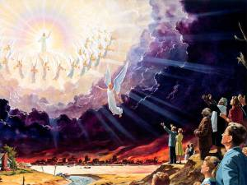
The Church that Jesus Built
This is a squint of the glorious church that Jesus is coming back for, made up of true disciples who make disciples, who maintain schools hospitals and humanitarian institutions which came from missions, that were birthed out of the revivals which followed the man who stood against the mockery of hypocrisy caused by the mess made by the priest who was a disciple who ate the yeast that lay in the church that Jesus Built

Slide 16

Goal for Lighthouse 2014
Winning the World for Jesus one Person at a time through Discipleship Relationships

Slide 17
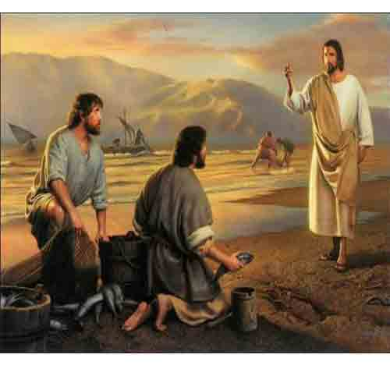
What is a Disciple?
Matt 4:18-20 "Come, Follow Me...“
One who has made Jesus Lord of their life
One who has entered a relational process of being discipled by a maturer Christian
One who is becoming Christlike
One who is Committed to the mission of Christ

Slide 18

Considering the Failing State of Today’s Church, There are Only Two Conclusions -
It's a sign of the times and not the church's fault but God's will - and therefore Jesus is returning very soon - before it's too late
It's the fault of the current western church - it's lost it's bearings and moorings - and it needs to return to its roots and become again the true church that Jesus built!

Slide 19
The Church Jesus Began to Build - that He has Invited us to Continue – is Made Up of:
Ordinary people who have realised their plight and need of a saviour/Jesus and surrendered to Him as Lord for salvation
They have fallen in love with God and His Son Jesus, filled with His Spirit, and desirous to do His will
Are engaged in a continuous discipling relationship with other maturer disciples and meet often for the purpose of spiritual growth
Are more centred on God's word and His standards than the modern church's interpretation of them - they are unafraid to be different
They are maturing into strong disciples of Jesus who are light and salt and want want to win the world for Him
They are desperately concerned for the lost, and the expansion of the kingdom of God before Jesus returns and it's too late

Slide 20
The church that Jesus Wants to Rebuild in our Day - and I see Lighthouse as being Part of:
Is full of people being changed from Glory to Glory into the image of Christ
Is made up of Discipleship relationships - cells - where everyone is connected and being challenged to grow and change into Christ's likeness
Is making an impact on the surrounding world through good works and social justice
Is empowered by the Holy Spirit to perform signs and wonders that go beyond natural explanation - all for God's glory
Is demonstrating the true love of God toward each other and the outside world - and being a rich blessing to the needy and poor
Is carrying the presence and authority of God in an unmistakable way through prayer, worship and intimate relationship with God
Is of great influence to the legislative processes of local and national government - making a difference in our world
Is glorious, shining, devil-scaring, sin-scouring, saint-envigorating, world-impacting and Jesus-pleasing ready for His return

Slide 21
Therefore, 2014 is a year of Reformation and Formation Toward this Glorious Goal
Souls being saved rather than people attending church
Lives being changed into Christ's image rather talents being flaunted
People on their knees in secret rather than busy 'serving the Lord' up front and noticed by all
People repenting of their sin toward God and one another rather than sermons that sound so good
People volunteering to serve, visit, minister, heal, witness and share Jesus rather than be on the membership roll
True worship in spirit and truth rather than great band, singers, equipment and a/v effects
Missionaries sent out to the nations to plant churches rather than swelling the ranks at home

Slide 22
Therefore, 2014 is a year of Reformation and Formation Toward this Glorious Goal
People rising into disciples that make disciples, rather than cell leaders who maintain good bible studies in well attended groups
People who feel the call to serve God and leave their comfortable western lifestyles and make sacrifices for the Kingdom of God
Marriages and families trusting God for grace instead of giving up and letting their marriage fail due to hard times
The power of the Lord being present to heal
The presence of the Lord being overwhelming, causing people to fear God, honour one another and serve Him with all their heart

Slide 23
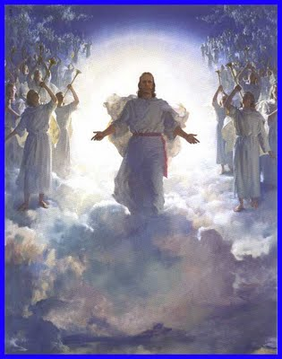
Are You Ready?

